Slide 1

Cross-Sentiment Analysis of Literature Sources using BERT
Capstone Project Phase B 23-2-R6
Authors:
Omer Asus
Alon Modin
Supervisors:
Dr. Renata Avros
Prof. Zeev Volkovich
GitHub repository: https://github.com/alonmodin1/Final-Project
1

Slide 2
Content
1
Problem Definition
7
Description of Technologies and Tools
2
BERT
8
Challenges and Problems we Faced
3
Transformer
9
Description of project metrics
4
Encoders
10
Incompliance with project metrics
5
Working Flow of the Project
11
Compliance with project metrics
6
System Requirements
12
Project Video
2

Slide 3
Problem Definition
3

Slide 4
Identifying Text Writers through Writing Style Analysis
Introduction
Objective: Identify text writers by analyzing their unique authorship style
Methodology: Analyze tweet-like texts using sentiment analysis methodology
4

Slide 5
Identifying Text Writers through Writing Style Analysis
Methodology
Challenge: Applying of sentiment analysis approach to differentiating authorships
Solution: Employ a BERT-based aspect-level sentiment analysis algorithm
Benefits of BERT: Contextual understanding and capturing language nuances
5

Slide 6
Identifying Text Writers through Writing Style Analysis
Dataset and Model Development:
Split long texts to short as tweets batches
Exploit BERT as the backbone for discerning and classifying tweet-like text
Validate the trained BERT model
6

Slide 7
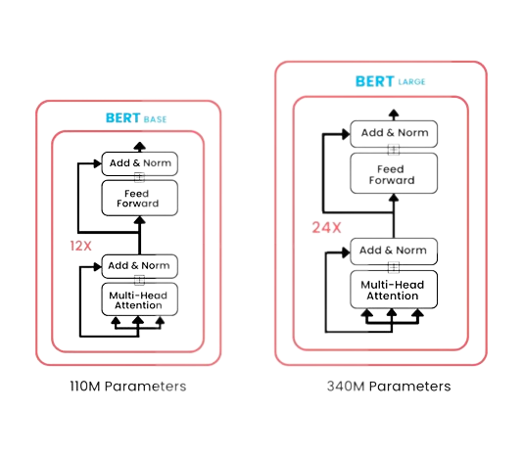
BERT(Bidirectional Encoder Representations from Transformers) Base and Large model
7

Slide 8
BERT: Advancing Natural Language Processing
Introduction
BERT is a transformer trained on huge datasets
BERT is constructed to treat NLP problems such as sentiment analysis, text generation, translation between languages, etc.
Significance: Revolutionized deep learning in natural language processing (NLP)
Key feature: Capturing contextual information bidirectionally
8

Slide 9
BERT: Advancing Natural Language Processing
Pre-training Phase:
Masked Language Model:
Model: Randomly masking tokens and predicting them based on context
Learning relationships between words within a sentence
Next Sentence Prediction:
Understanding sentence-level relationships
Capturing dependencies between sentences
9

Slide 10
BERT: Advancing Natural Language Processing
Fine-tuning and Transfer Learning:
Fine-tuning BERT for specific tasks:
Adding task-specific layers and optimizing on task-specific datasets
Examples: Text classification, named entity recognition, question answering
Knowledge transfer:
Leveraging learned representations for downstream tasks
Achieving state-of-the-art performance in NLP benchmarks
10

Slide 11
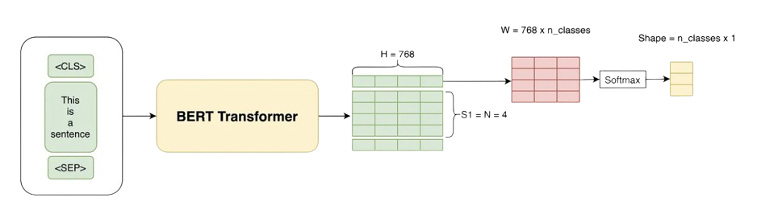
Transformer
11

Slide 12
Transformer Architecture for Natural Language Processing
Introduction
Purpose: Process and analyze sequential data, particularly text
Composition: Self-attention mechanisms, feed-forward neural networks, positional encodings
Advantages: Effective modeling of long-range dependencies, scalability to handle large-scale datasets
12

Slide 13
Transformer Architecture for Natural Language Processing
Functionality :
Self-Attention Mechanisms:
Capture contextual relationships between words
Enable modeling of long-range dependencies
Feed-Forward Neural Networks:
Process information and extract features
Learn complex patterns and representations
Positional Encodings:
Provide positional information
Enable understanding of sequence order
13

Slide 14
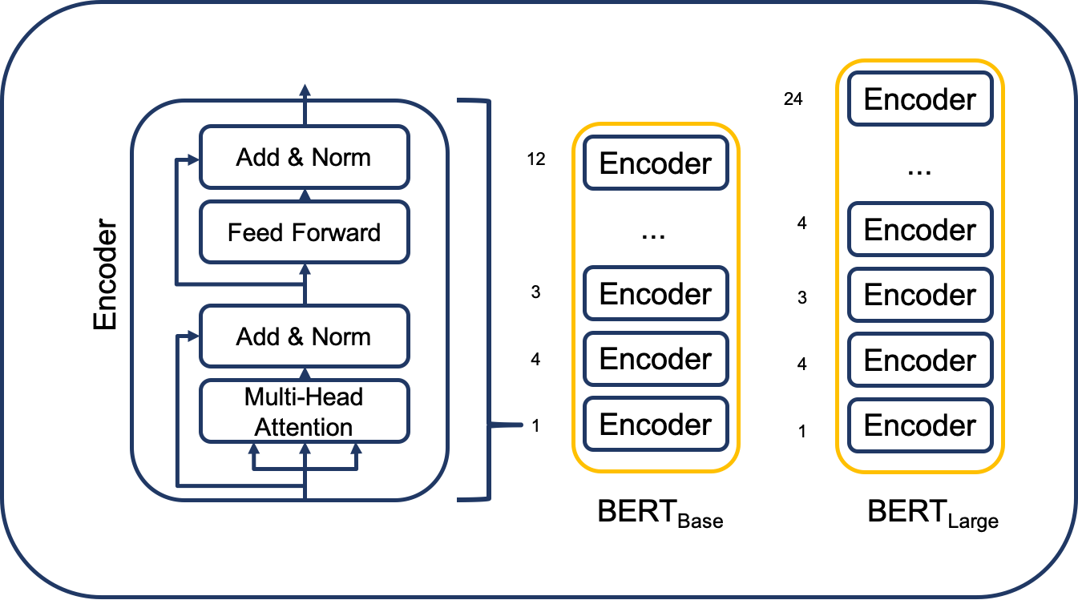
Encoders
14

Slide 15
Encoders in Deep Learning
Definition: Encoders transform input data into compressed representations.
Purpose: Reduce complexity and extract important information.
How it works:
Input Data
Extract Features
Capture Patterns
Encoders are utilized in both base and large BERT models.
The encoders in BERT can be fine-tuned aiming to adapt to a specific task.
15

Slide 16
Working Flow of the Project
16

Slide 17
The main idea is to employ the sentiment analysis methodology.
From our perspective, each text is divided into small, like a tweet, portions.
Sentiment analysis determines the underlying sentiment expressed within a small text piece.
In our connotation, “positive” and “negative” means different authorships.
To deal with the problem, we intend to employ a BERT-based aspect-level sentiment analysis algorithm for cross-domain text.
BERT, a pre-trained language model, is known for its ability to comprehend contextual information and capture intricate language nuances.
17

Slide 18
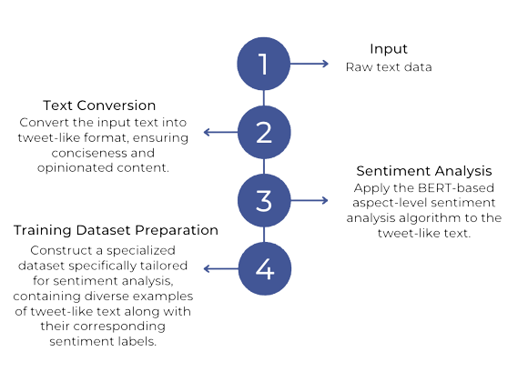
18

Slide 19
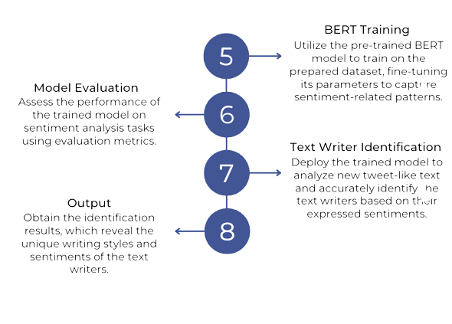
19

Slide 20
System Requirements
Converting Shakespeare's and non-Shakespearean poems to CSV files that match the system requirements (contain Tokens Tags Polarities)
Adding an additional layer for the purpose of fine tuning on a pre-trained BERT model.
Training the layer using the input files we created in step 1
Validate the Model
Predict on the Model
20

Slide 21
Description of Technologies and Tools
Our solution utilizes advanced natural language processing techniques, primarily centered around the BERT model architecture, for authorship identification.
Technologies Utilized:
BERT, PyTorch, Transformers Library, Pandas
Dedicated Software Tools:
BERT Tokenizer, PyCharm, Jupyter Notebook, Microsoft Excel, GitHub
21

Slide 22
Challenges and Problems we Faced
Training Time and Resource Constraints:
Long training times due to the size and complexity of the BERT model, especially with large datasets.
Resource constraints such as limited access to high-performance computing resources or GPU clusters.
Solution:
We utilized a pre trained BERT model and trained additional layer on that model to save a lot of training times
We used virtual machines with many CPU’s and very high RAM to make the training run faster
22

Slide 23
Challenges and Problems we Faced
Complexity of Language:
Analyzing historical texts, especially those written centuries ago like Shakespeare's, presents a challenge due to the evolution of language over time. The archaic language used by Shakespeare requires special handling to ensure accurate processing and classification.
Solution:
Employed advanced NLP techniques, including pre-trained language models like BERT, capable of capturing complex language patterns and nuances, thus enhancing the model's ability to differentiate between authors.
23

Slide 24
Description of project metrics
Accuracy of at least 88 percent
A loss of no more than 25 percent
The success of predicting the author of the poem
24

Slide 25
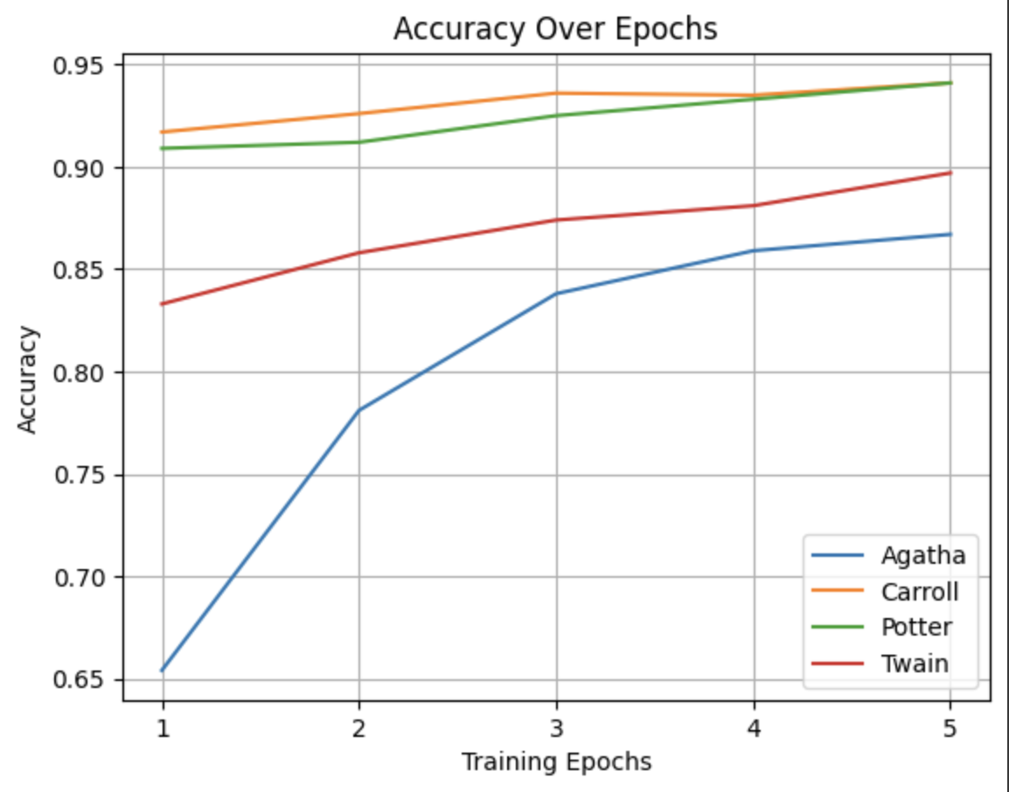
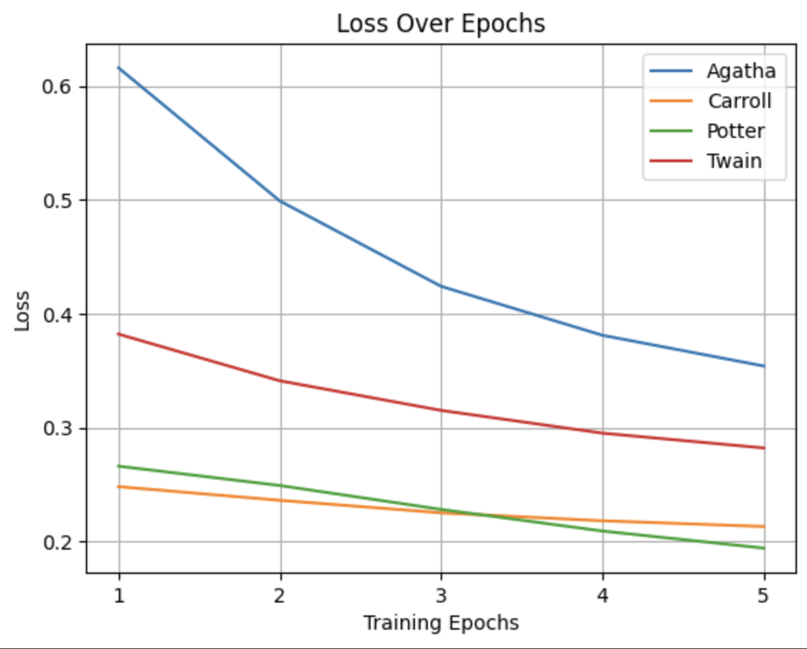
Incompliance with project metrics
10 Shakespeare poems:
25

Slide 26
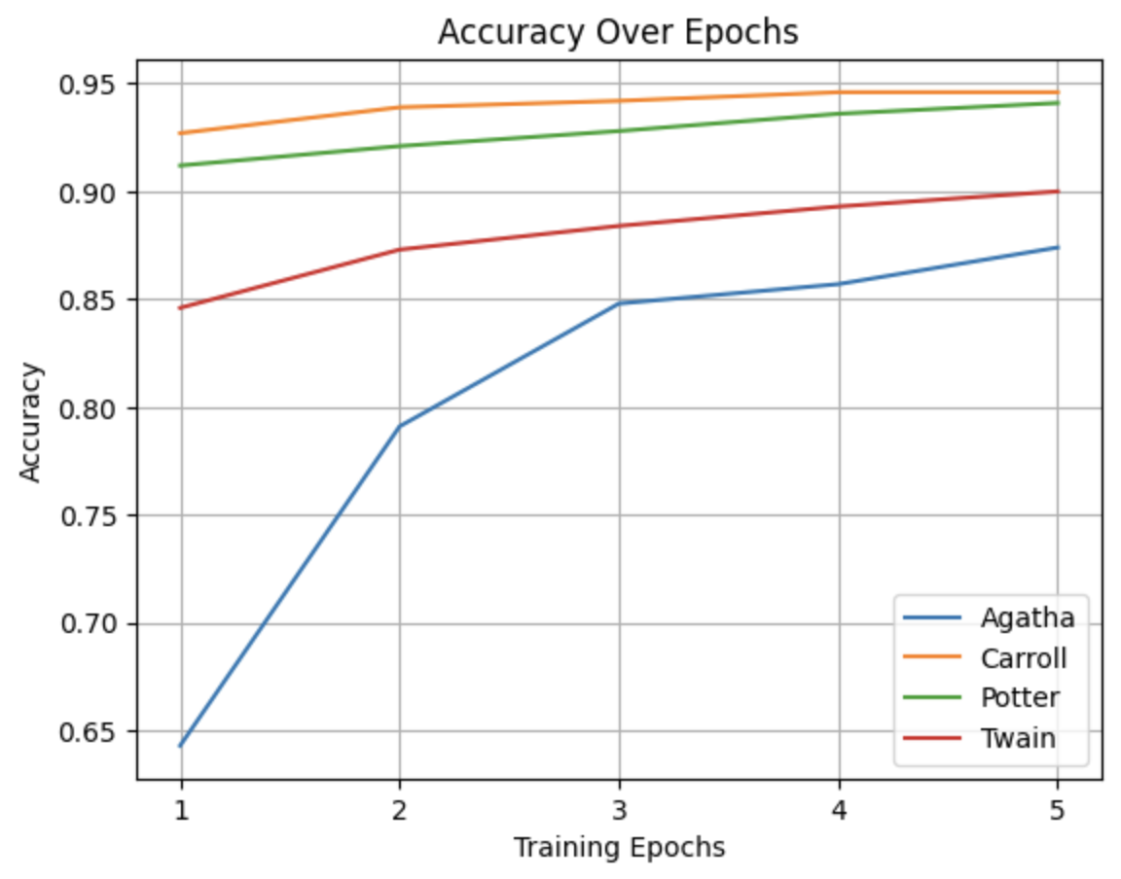
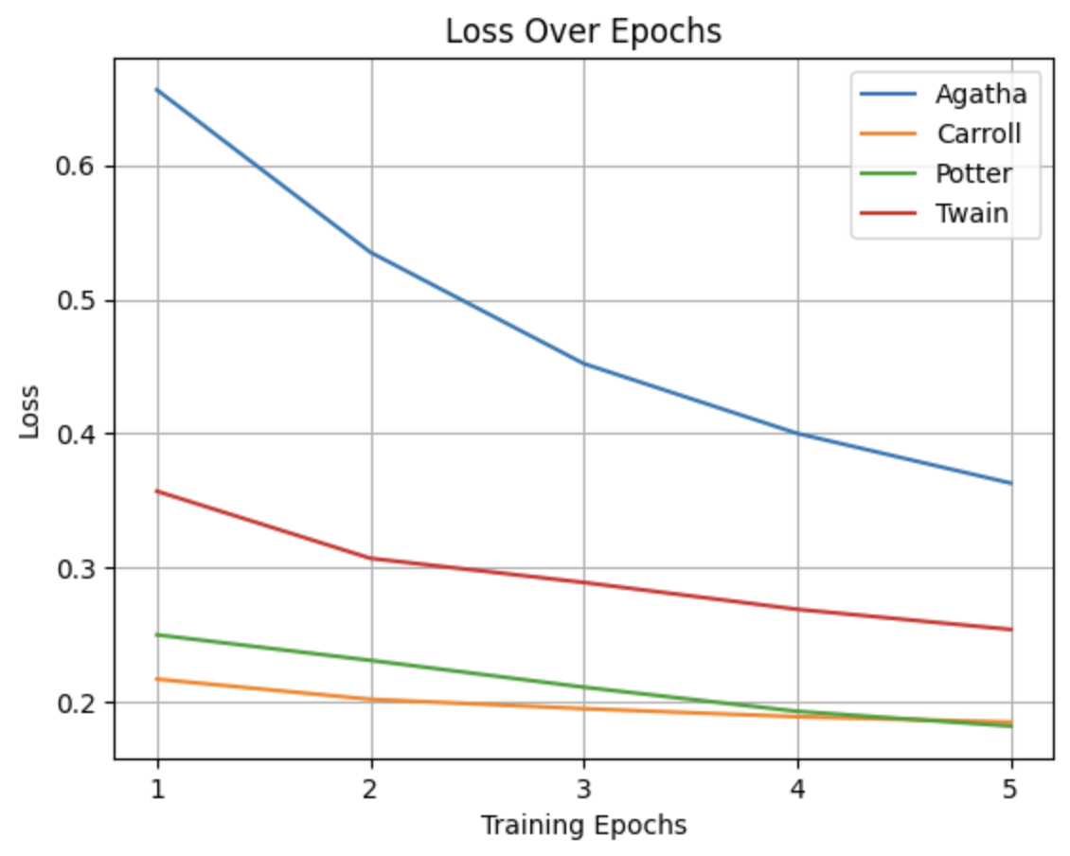
Incompliance with project metrics
15 Shakespeare poems:
26

Slide 27
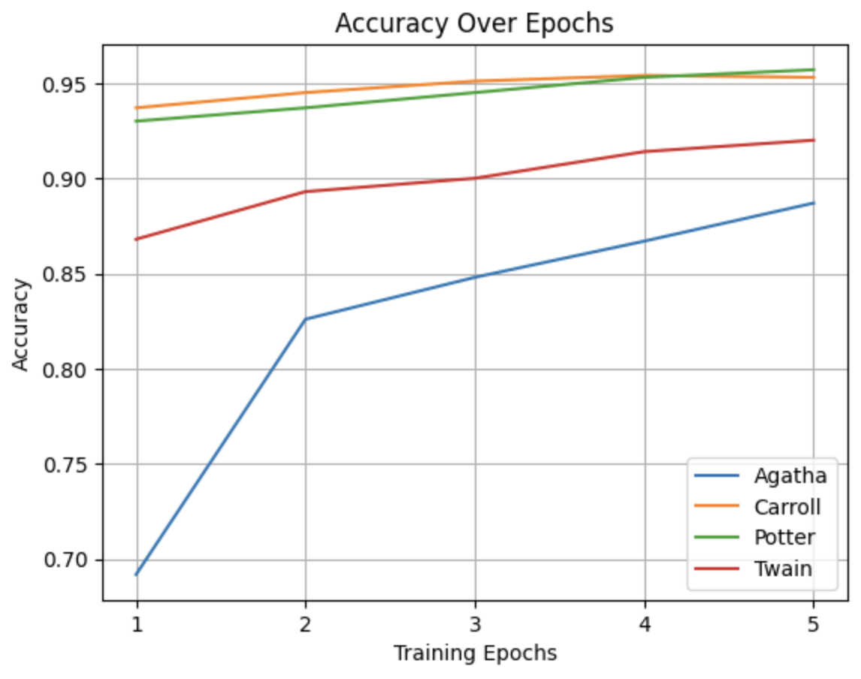
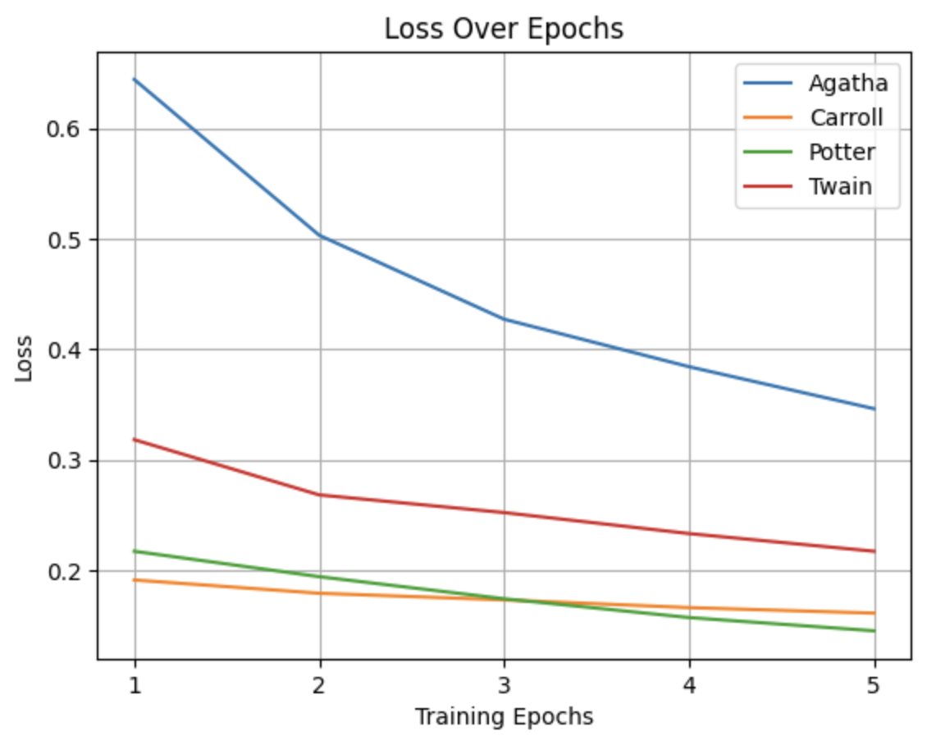
Incompliance with project metrics
20 Shakespeare poems:
27

Slide 28
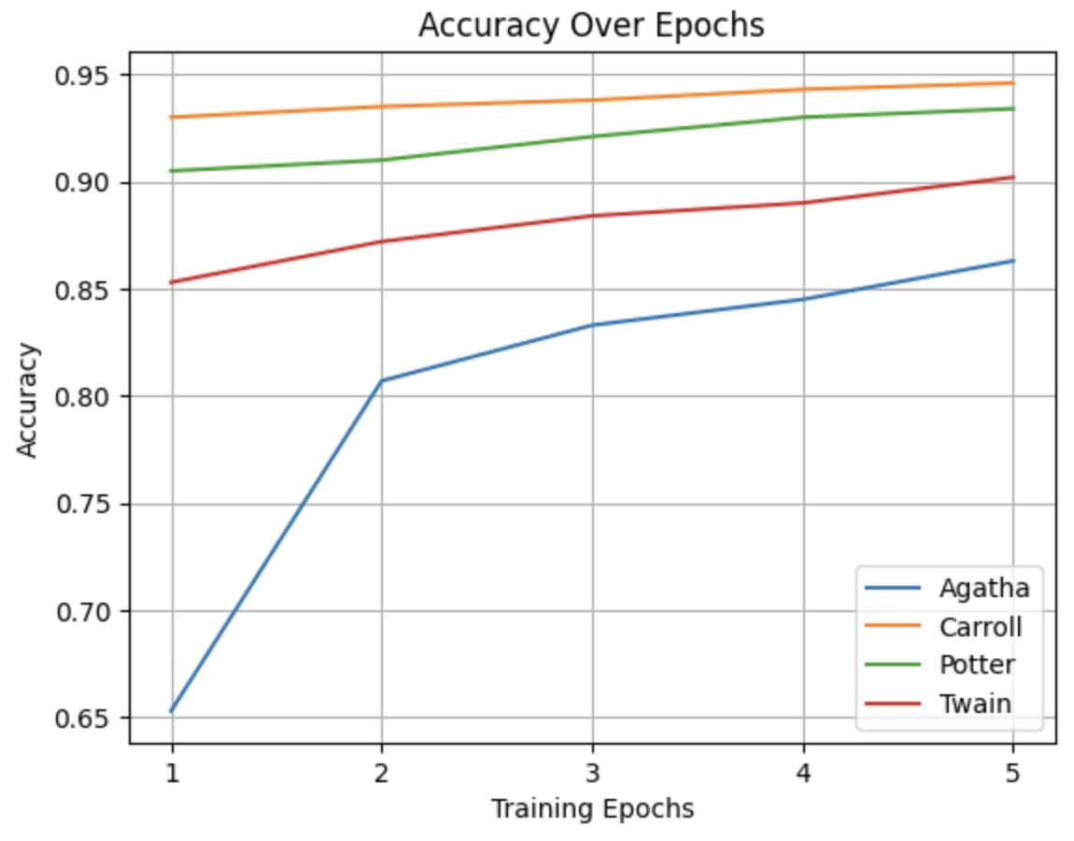
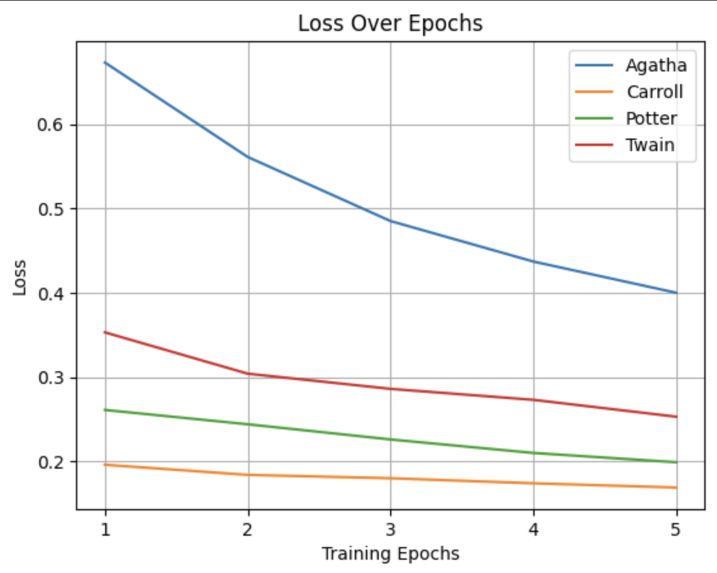
Incompliance with project metrics
25 Shakespeare poems (5e-5):
28

Slide 29
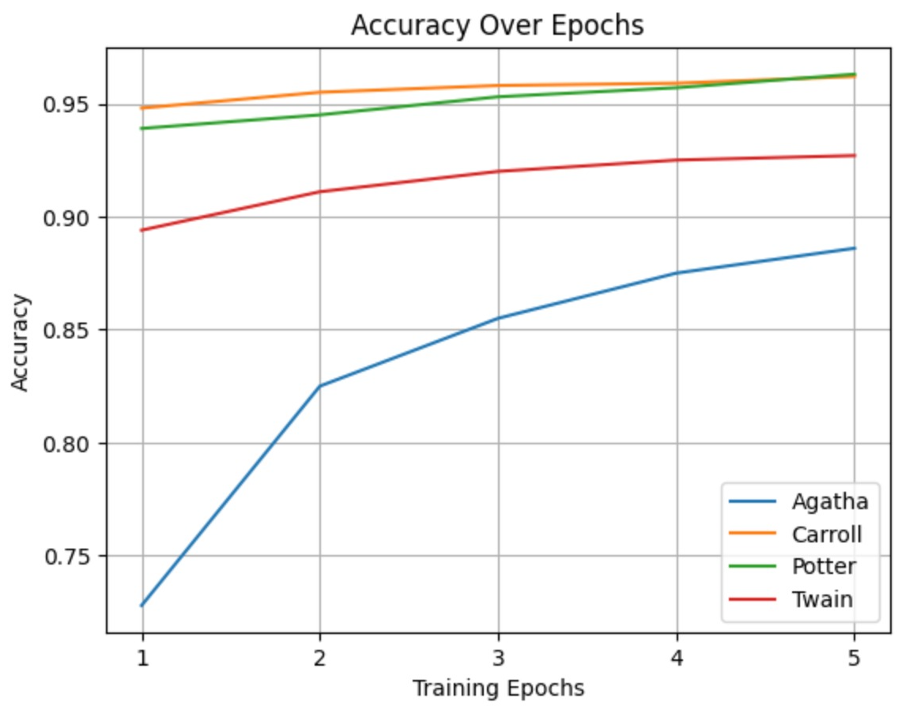
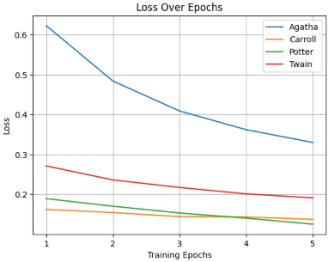
Compliance with project metrics
The chosen solution :
29

Slide 30
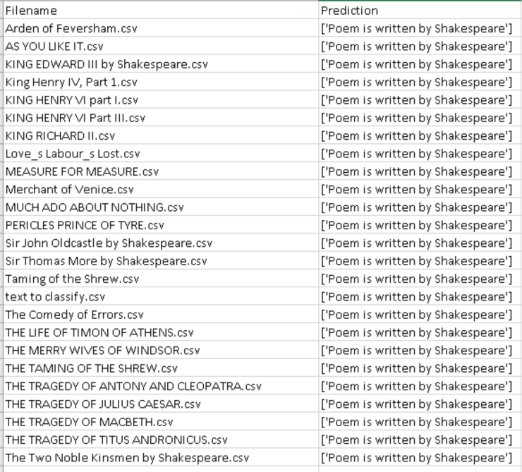
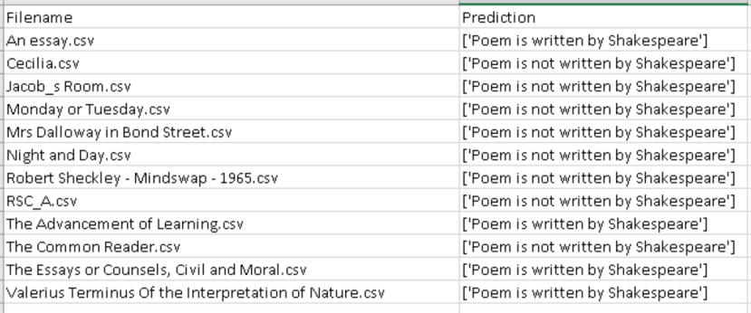
Compliance with project metrics
Shakespeare :
Non-Shakespeare :
30

Slide 31
Project Video
31

Slide 32
The video located under the Part B folder and named Final_Video.mp4
32

Slide 33

33

